Slide 1


Congressional Vote Clustering
Group 2: Le Nguyen, Greeshma Ganji, Tolulope Olatunbosun, Nandhini Lakshman

Slide 2

Table of Contents
Problem Description
Data Mining
Data Cleaning
Data Analysis
Creating a model
Results
Conclusion
References

Slide 3
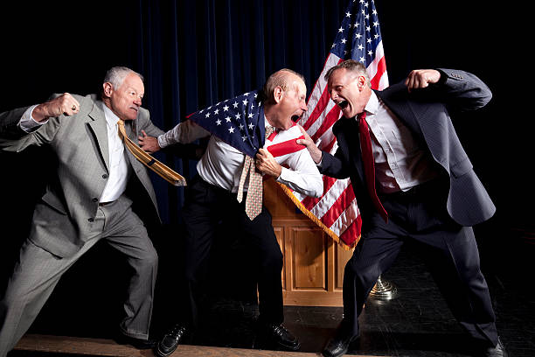
Problem Description
Current American politics is very divided along party lines
We want to see if this political divide shows up in the data
Can members of congress be clustered into the two parties based on their voting record?
Do members of the same party tend to vote with each other?
Are some members willing to vote against their own party?
Are there some members that are hard to classify based on their voting recording?

Slide 4
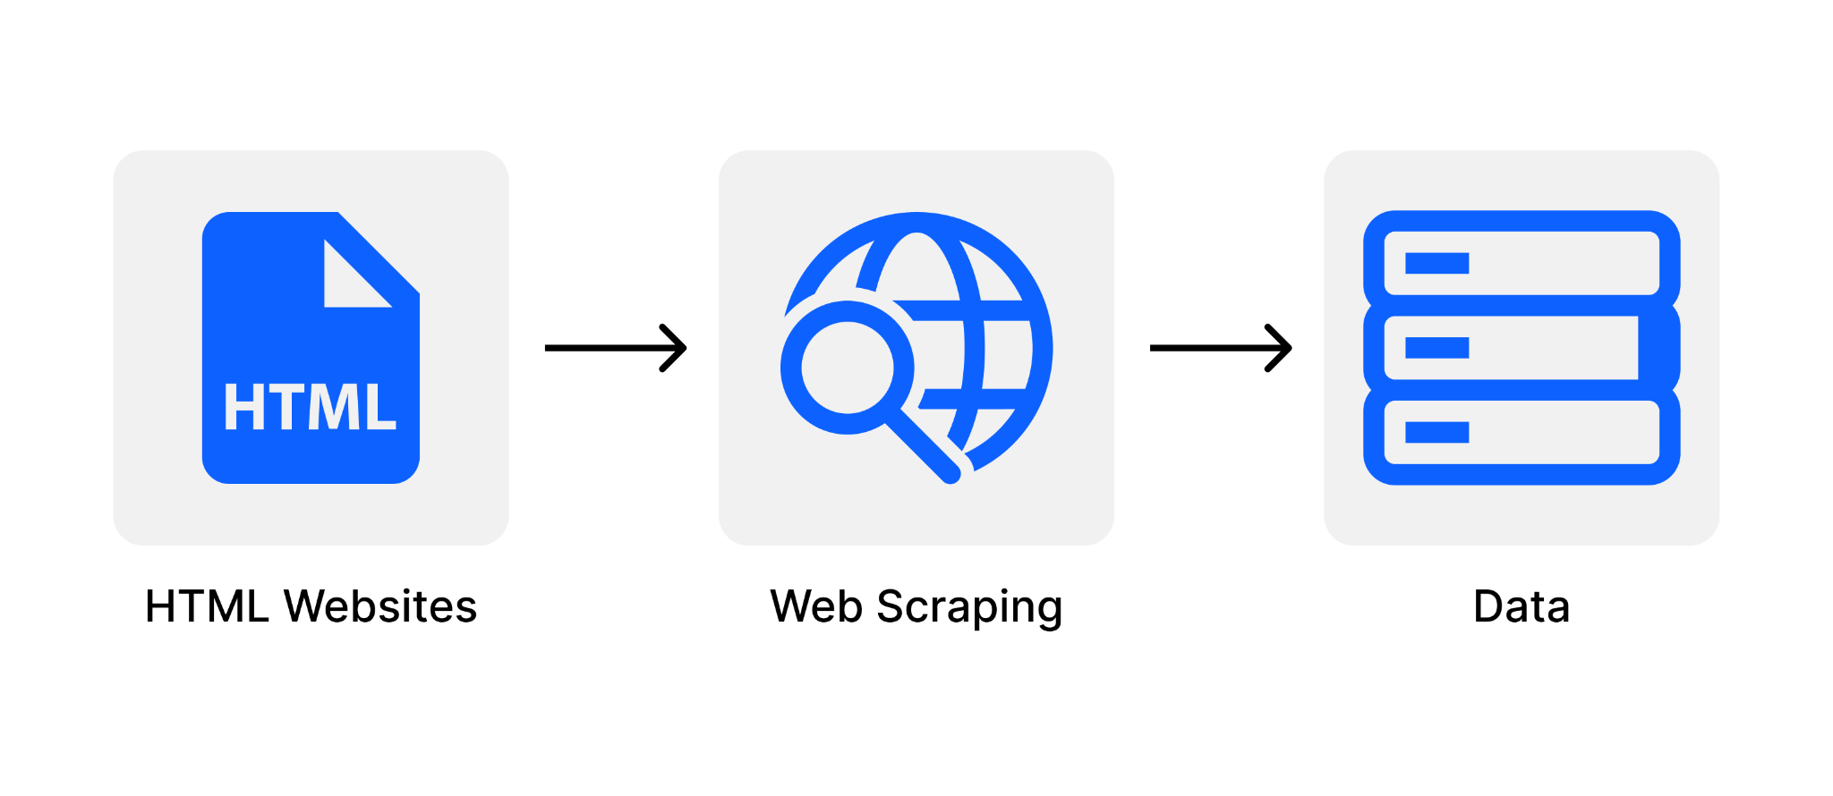
Data Mining: Web Scraping
Web Scraping: collected relevant data from a given website
For every bill, take the congressperson and their vote on said bill
Collect this information on all bills to build a data set
We haven’t done this in class, so let’s take a look at what this looks like!

Slide 5
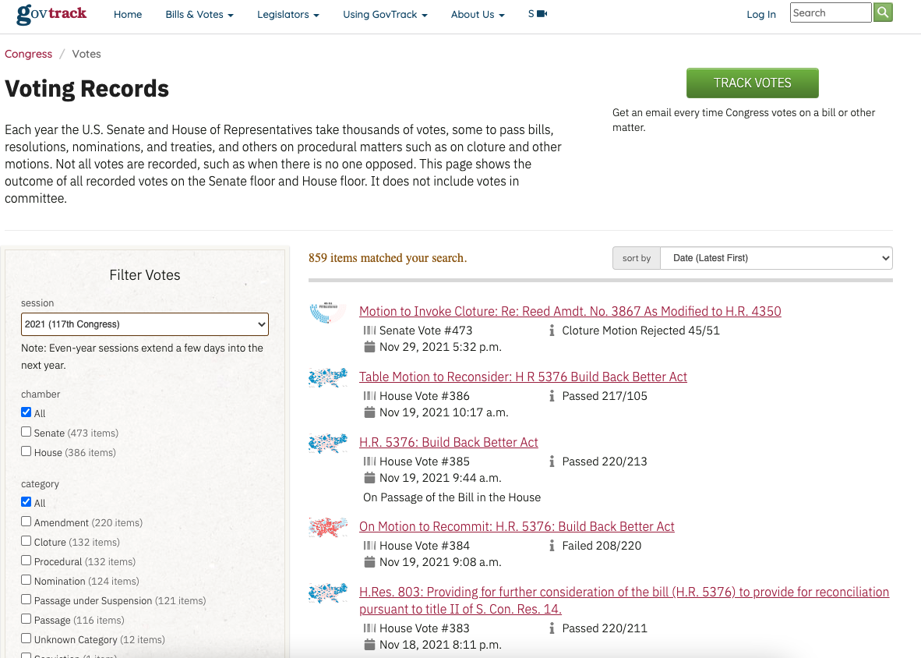

Slide 6
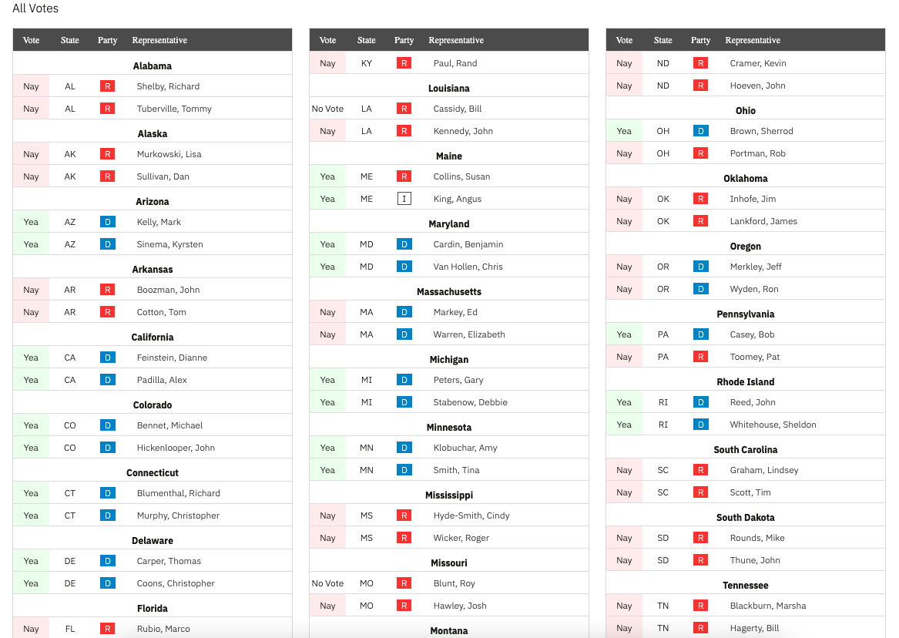
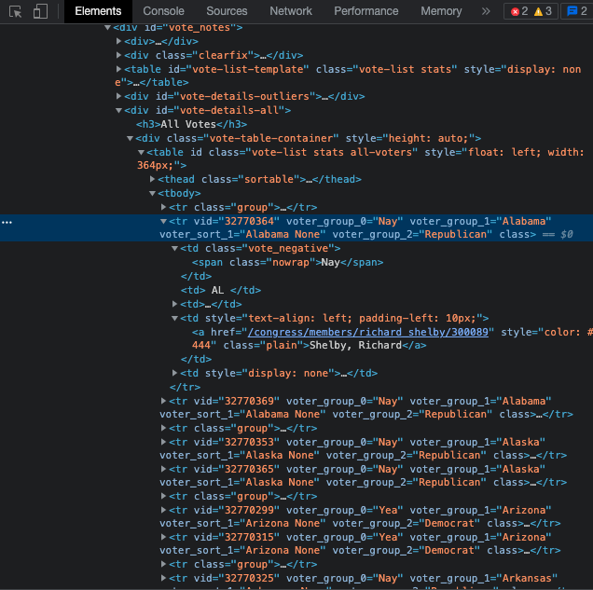
Inspect

Slide 7
Data Cleaning
Problem | Solution
Two word states listed in multiple indices (list[0] = “New”, list[1] = “York”) | Append indices together where this happened
Not every member of congress votes on every bill, ragged data set | Create a list of all congress people, add missing people into bills they didn’t vote on. Assume they would vote with their party.
Data in string format “Yea” or “Nay” | One hot encode string values “Nay” = 0, “Yea” = 1

Slide 8
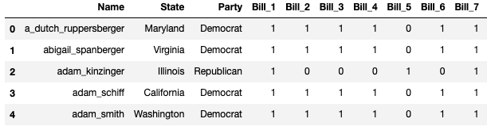
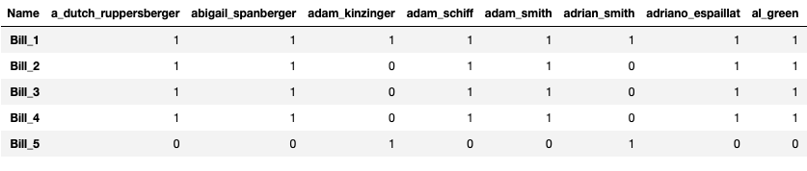
Clean Data
Transpose

Slide 9
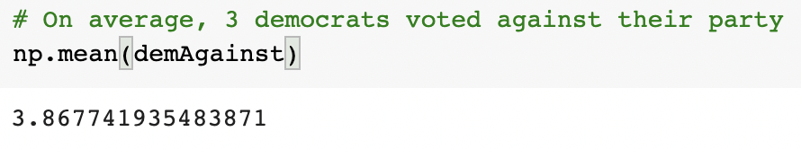
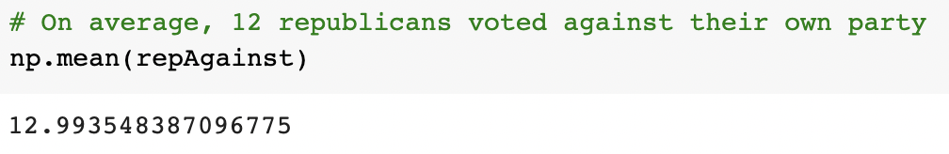
Data Analysis
Finding the mean count of democrats and republicans who voted against their party for all 311 bills
Gives us an idea about voting behaviour and certain outliers

Slide 10
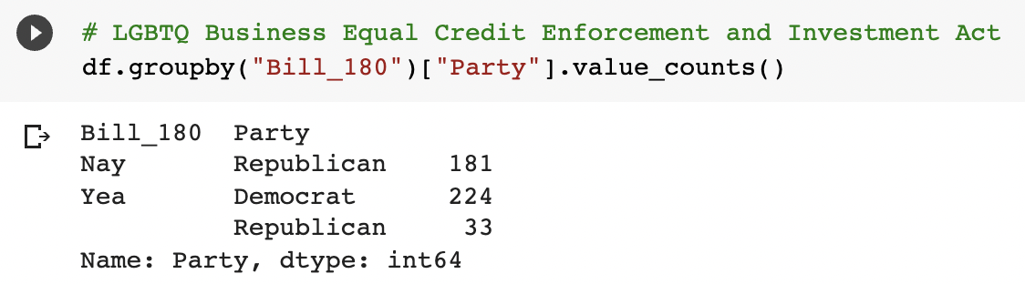
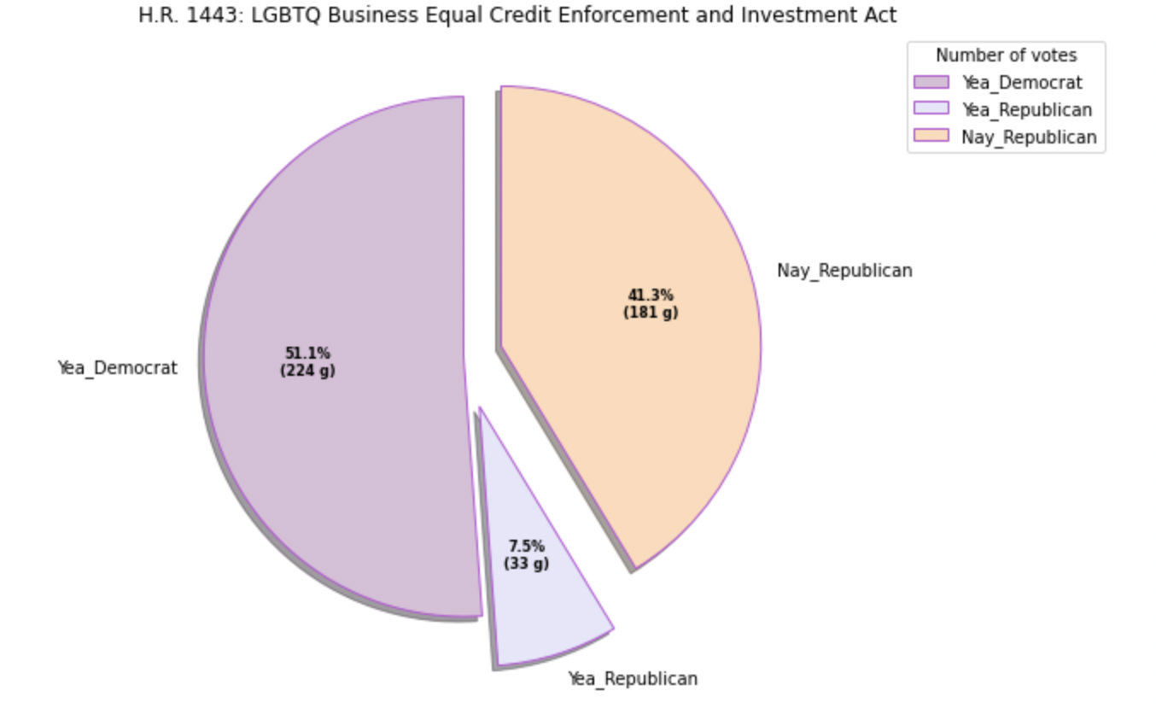
Data Visualization

Slide 11
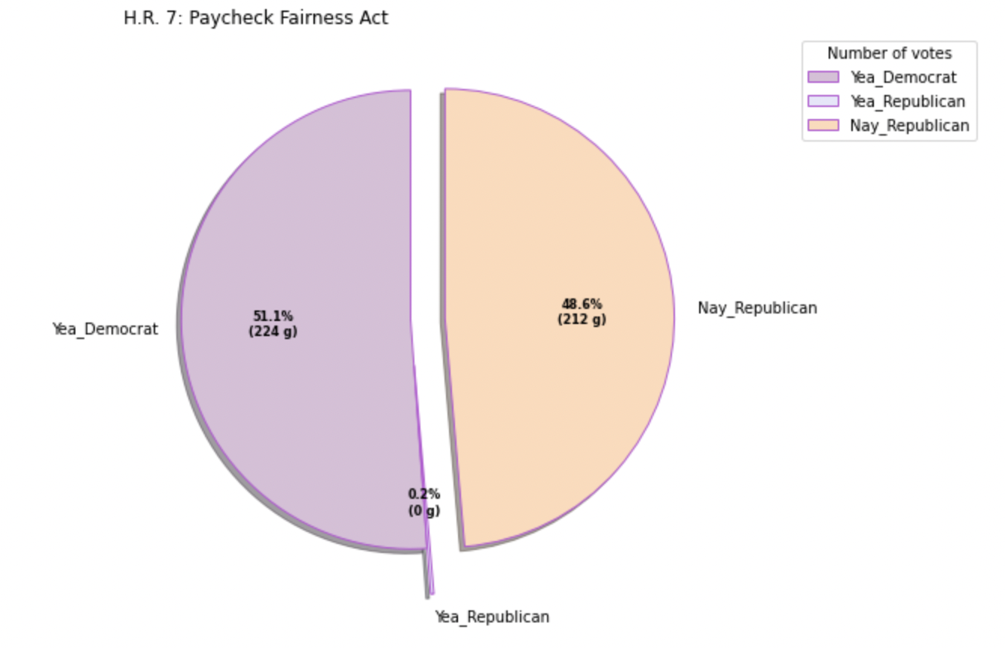

Slide 12
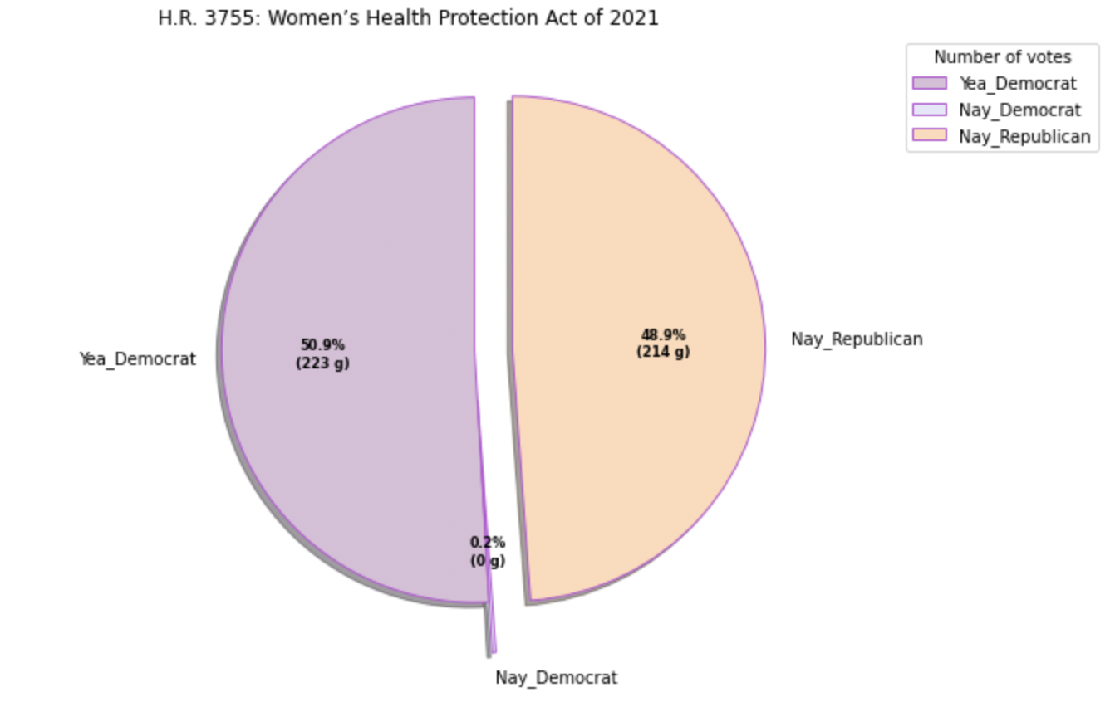

Slide 13
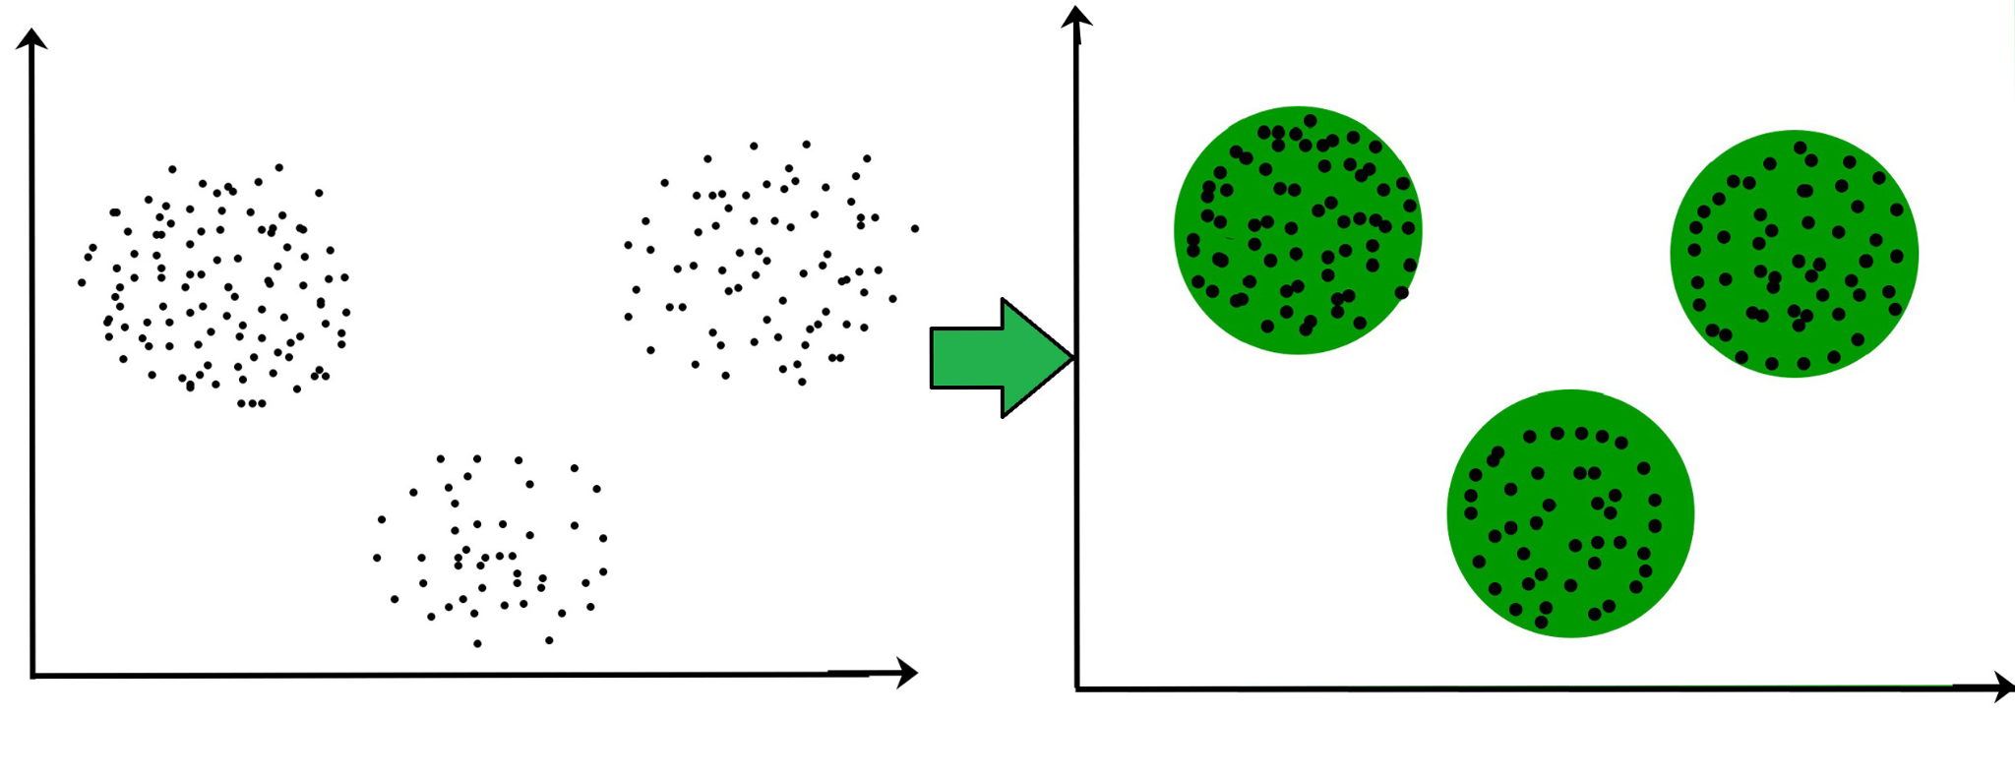
Model Creation
We want some algorithm that can look at how each person voted and classify them
First need to define some distance metric to determine how close one congressperson is to another — many such metrics exist: Manhattan, Euclidean, Cosine Similarity, Jaccard, and more
Use an algorithm that can take in the distances to make clusters
Will everyone cluster into their own party?
Will there be some people who are difficult to cluster?

Slide 14
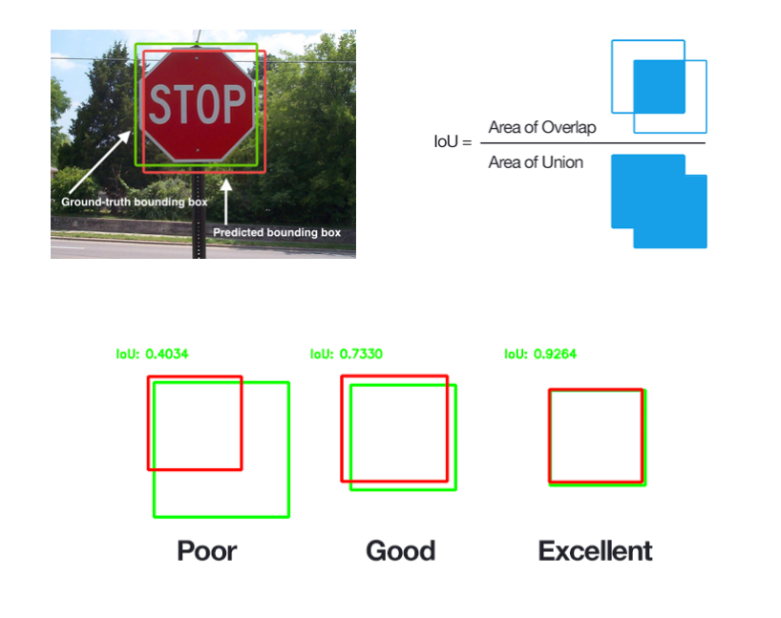
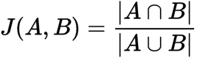
Jaccard Distance
Generally speaking, the Jaccard index is used when there are binary situations. This is fitting in our context as we manipulated the data to go from 3 voting options (Yea, Nay, Not Voting) to 2 options (Yea, Nay) with data imputation — based on mode of data set since such small percentage voted against their party.
Aided in binarizing the choices.

Slide 15

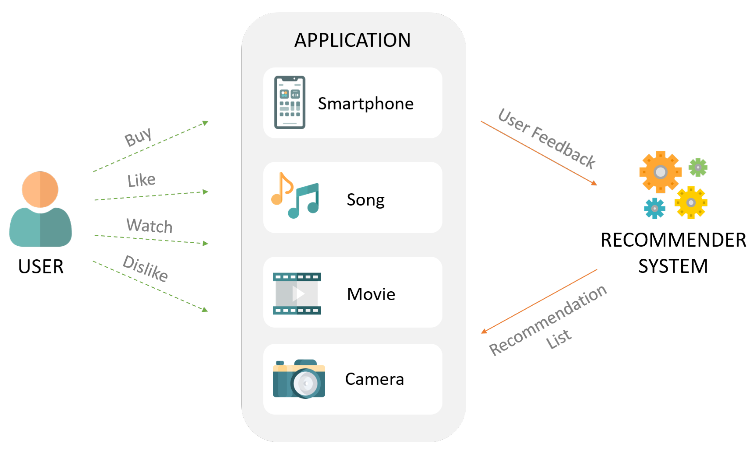

Jaccard Distance Use Cases
Recommendation Systems
E-Commerce
In Natural language processing, Jaccard distance is often used to measure text similarity analysis — how much word choice overlap exists between documents. This pattern analysis is often used for plagiarism detection.

Slide 16
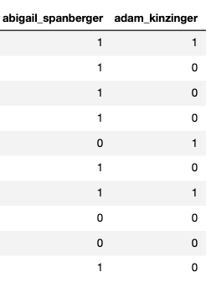
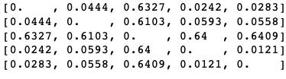
Jaccard Distance Results
Often used to measure similarity and diversity of data sets.
Jaccard Distance = intersection of A&B/Union of A&B
Elements of A in B/All elements in A and B
Where both people vote together/All votes
J(Spanberger,Kinzinger) = 0.61. This is a relatively high distance between politicians, suggesting perhaps they are polar and that they disagree on most issues.
We can then produce a distance matrix- distance from one person to everyone else

Slide 17
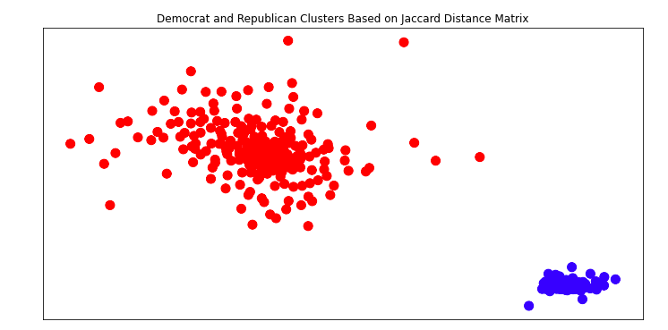
Plotted Distance Matrix
Republicans
Democrats

Slide 18
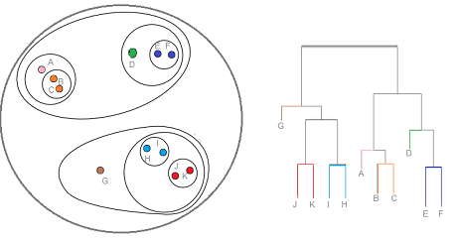
Hierarchical Clustering
Given the distances between each point we can use Hierarchical Clustering
This will group all points closest to each other then group all clusters closest to each other

Slide 19
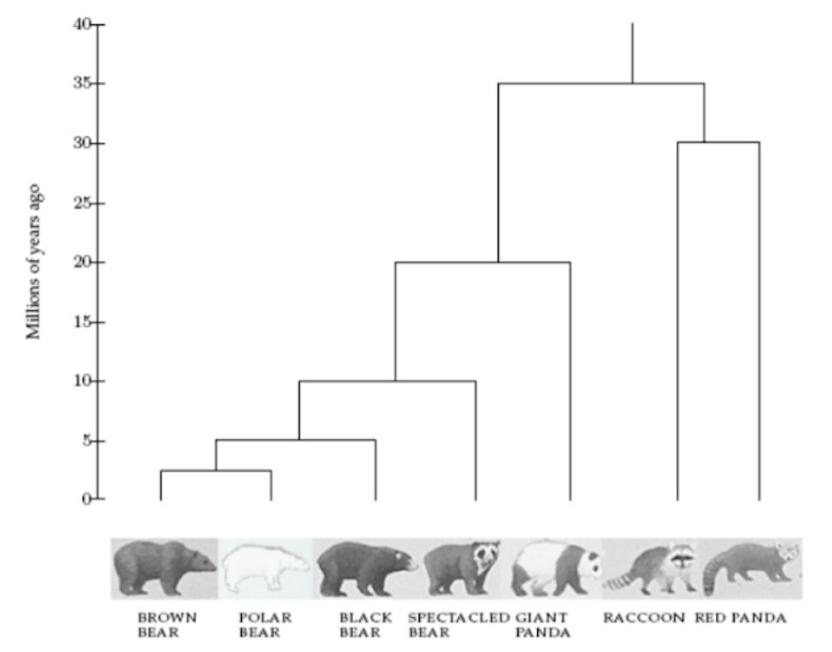
Hierarchical Clustering Example

Slide 20
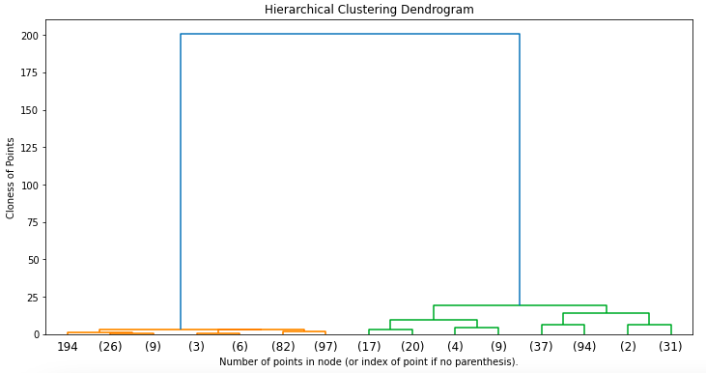
Results
Accuracy
(Y_pred == Y)/len(Y) *100
= 100%
Democrats
Republicans

Slide 21
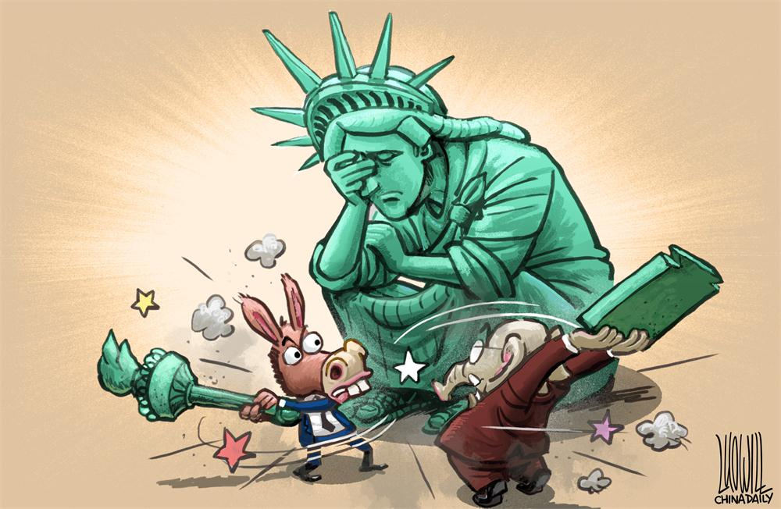
Conclusion
Initial analysis in the data reflected the political division in congress
This was further shown by using a distance metric to measure see how close/far people voted in their own party
The vast difference in voting between the parties made clustering them accurately easy

Slide 22
References
Congressional Votes Database
https://www.govtrack.us/congress/votes
Related Article
https://www.forbes.com/sites/ericaswallow/2013/11/17/senate-voting-relationships-data/?sh=427aac744031
Sklearn Algomeratrive Clustering
https://scikit-learn.org/stable/modules/generated/sklearn.cluster.AgglomerativeClustering.html
Plotting Distance Matrix
https://stackoverflow.com/questions/36339865/generating-graph-from-distance-matrix-using-networkx-inconsistency-python

